Slide 1
Introduction
This project focuses on detecting AI-generated faces using a GAN-based approach, leveraging the discriminator as a binary classifier to distinguish between real and synthetic facial images. Generative Adversarial Networks (GANs, have demonstrated the ability to generate photorealistic human faces, making it difficult for traditional detection systems to differentiate them from real images. AI-generated faces, while useful in media and avatars, pose risks when misused in deepfakes, identity fraud, or misinformation. The discriminator, trained on real images from the FFHQ dataset and fake images from thispersondoesnotexist.com, learns to identify subtle artifacts in synthetic images using features such as texture inconsistencies and unnatural patterns. The model is trained using techniques like Automatic Mixed Precision (AMP) and label smoothing for improved stability and performance, and its effectiveness is evaluated using metrics such as the confusion matrix, precision, recall, F1-score, and ROC curve. The scope of this work is limited to static image classification and does not extend to video or facial attribute manipulation, although the model’s modular design allows future enhancements. The proposed approach is lightweight, scalable, and suitable for real-time deployment in applications such as digital forensics, social media moderation, and identity verification systems.

Slide 2
GAN Algorithm
GANs have shown outstanding ability in producing realistic images, especially human faces. The evolution from simple GANs to sophisticated versions such as Deep Convolutional GAN (DCGAN), Style-GAN, and StyleGAN2 improved the quality of generated images significantly. StyleGAN specifically added style-based architecture and progressive growing methods that allowed high-resolution photorealistic human face synthesis. These are both frequently unrecognizable from real photographs, posing a difficulty for detection algorithms and with significant implications for electronic authenticity.

Slide 3
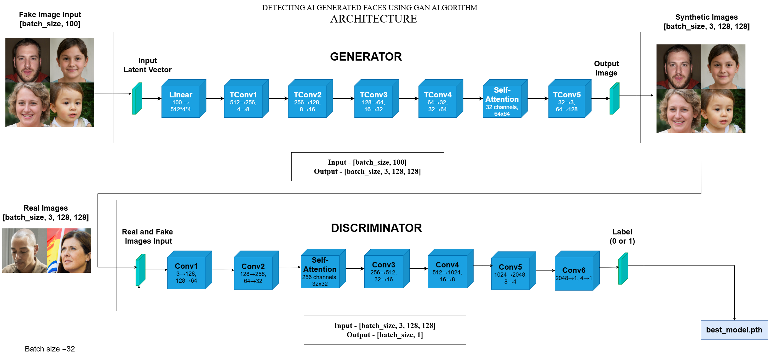
GAN Architecture

Slide 4
Generator
In this project, the generator plays a crucial role in synthesizing fake face images from random noise vectors. It is built using multiple transposed convolutional (ConvTranspose2D) layers to progressively upscale the noise into high-resolution 128×128 RGB images. The generator is trained alongside the discriminator in an adversarial setting, where it learns to create increasingly realistic fake images that can potentially fool the discriminator. Although the generator is not used directly in the final classification task, its outputs are essential during training. By continuously challenging the discriminator with high-quality fake faces, the generator indirectly enhances the system’s ability to distinguish between real and AI-generated images with greater accuracy.

Slide 5
Discriminator Classifier
In a standard GAN architecture, the discriminator learns to classify between real data and synthetic data created by the generator. Nevertheless, the discriminator may be learned so that it is used as a binary classifier itself. For this project, the discriminator learns to differentiate between real and generated images as well as to extend its ability beyond distinguishing between outputs from the generator. With ample training, the discriminator gains the capability to learn to recognize imperceptible features and irregularities in fake images, including noise in textures, unnatural symmetry, or inconsistent illumination. This positions it as an efficient and minimalistic solution to real-world detection problems without necessarily needing cumbersome multi-stage models.

Slide 6
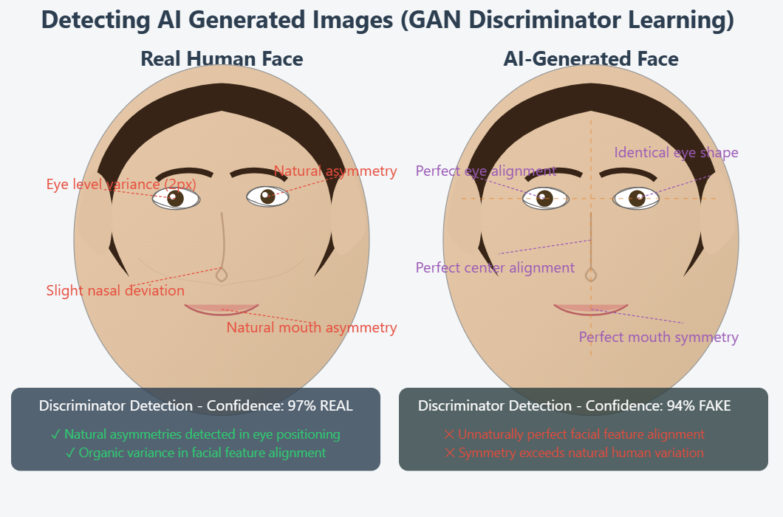
How Discriminator Learns
The discriminator in a GAN receives both real images (from the dataset) and fake images (generated by the generator), and gradually learns to tell them apart by assigning high confidence to real images and low confidence to fake ones. The discriminator learns to detect real and fake images by focusing on key facial features like the eyes, nose, and mouth. In the image you provided, the eyes are level and symmetrical, the nose is centered, and the mouth is well-aligned below the nose. The discriminator uses these correct positions and shapes as reference patterns. During training, it compares these natural alignments in real images with inconsistencies in fake ones, gradually learning to spot unnatural or distorted features to improve its classification accuracy.

Slide 7
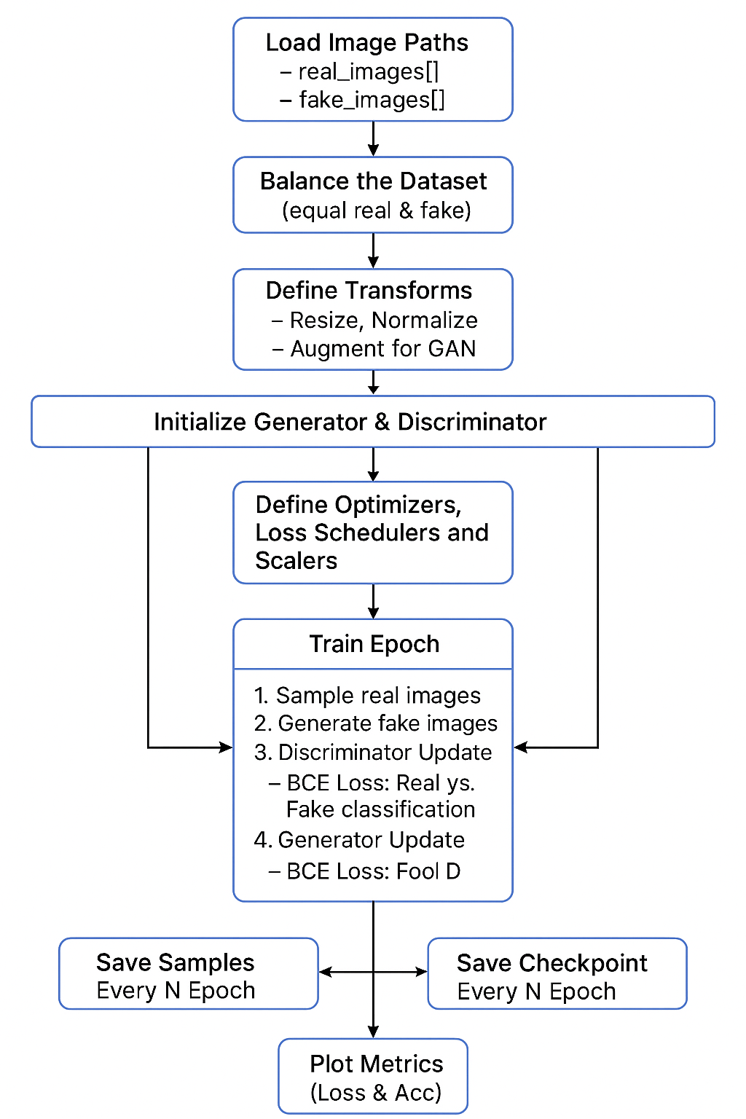
Data Flow Diagram

Slide 8
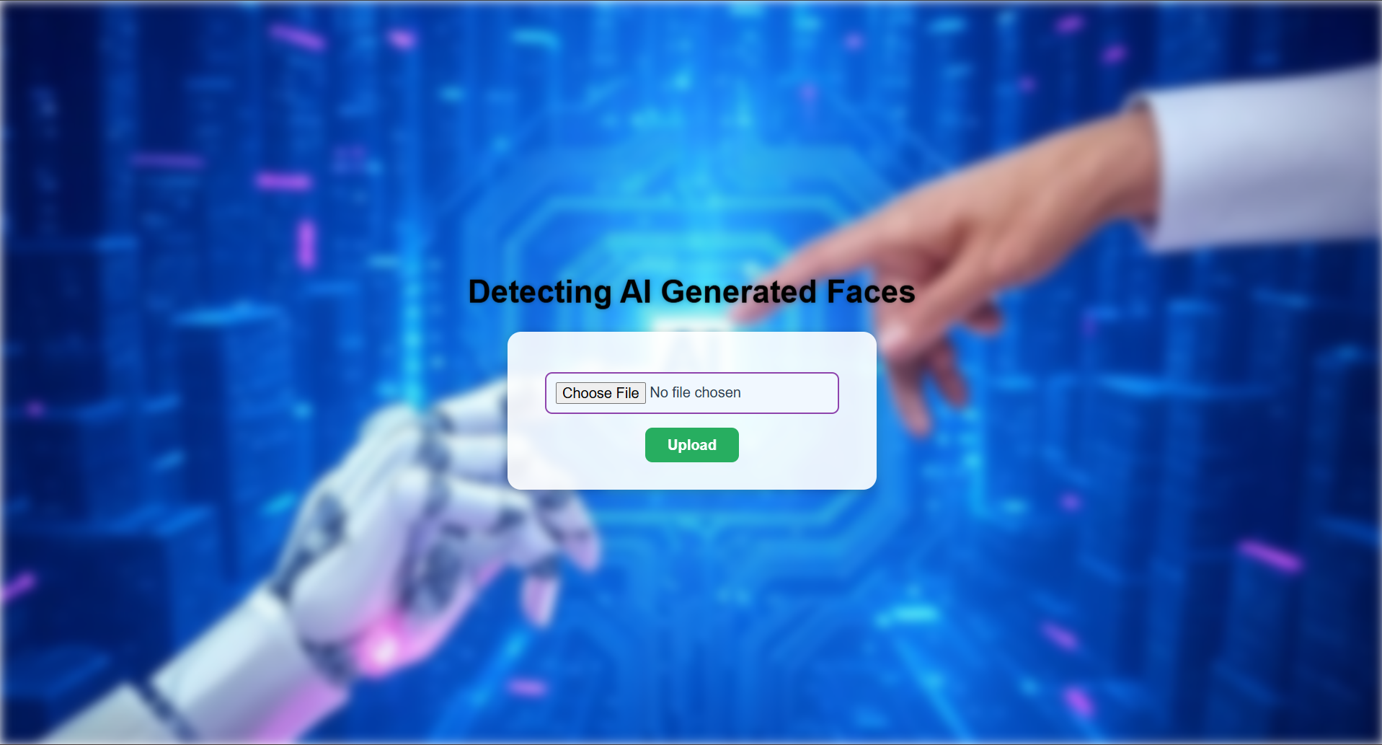
Result – Web Application Interface
We built a frontend using Html and CSS that allows users to upload an image.

Slide 9
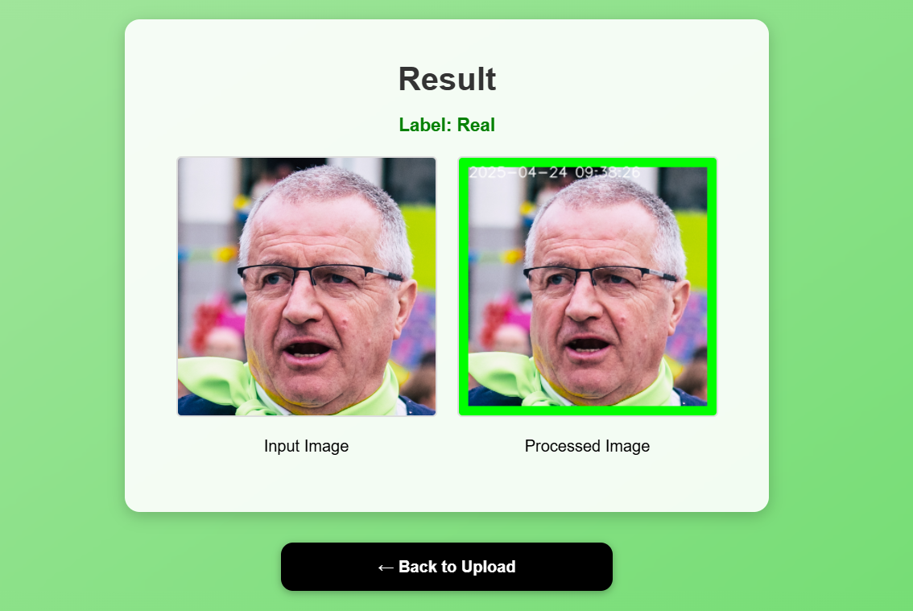
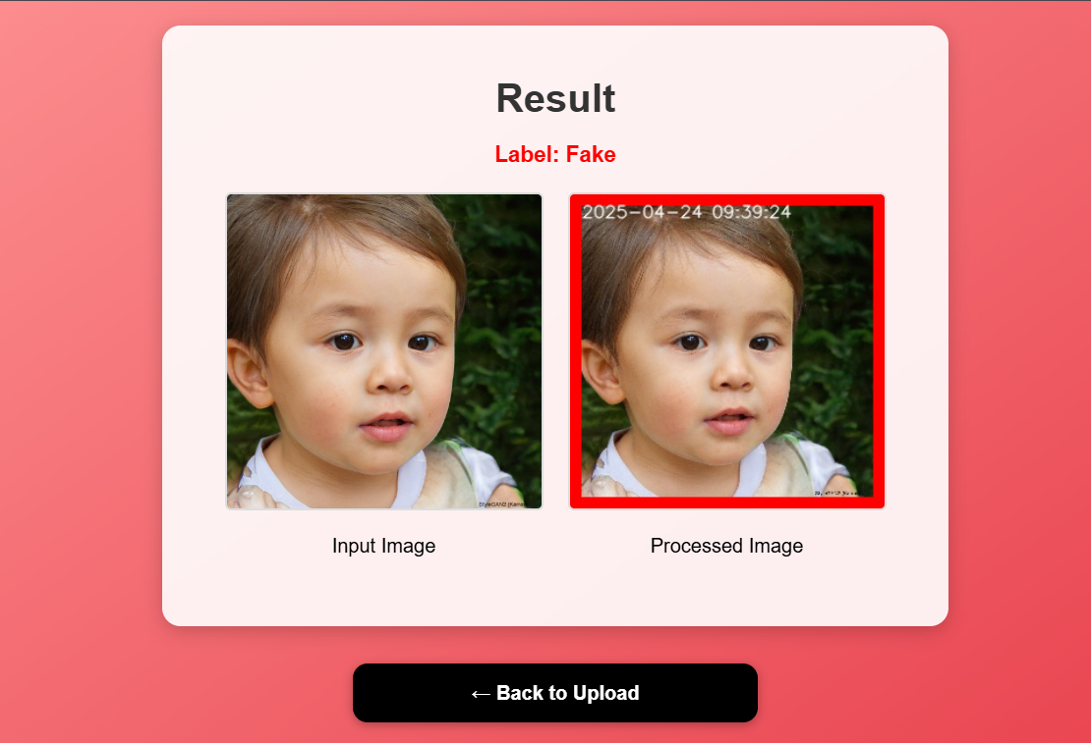
Result-Output
The app passes the image to the trained discriminator model. The model classifies the image as Real or Fake.
A green (Real) or red (Fake) border is shown around the result and displays the time and date.

Slide 10
Conclusion
A system based on deep learning was created to identify AI-generated human faces by creating a tailored GAN architecture. Real face images were employed from the FFHQ dataset, and synthetic images were obtained from thispersondoesnotexist.com, which utilizes StyleGAN to produce artificial faces. A discriminator network, trained together with a generator, was ultimately utilized as a binary classifier to identify real and artificial facial images. The model was trained on a balanced set of 20,000 images and was tested on a held-out test set of 3,000 samples. The outcomes showed excellent training stability, with the discriminator reaching perfect accuracy in subsequent epochs and test accuracy of 98.58% at the final stage, reflecting excellent generalization and robustness.

